Slide 1

Financial Reconciliation
Regis University
CCIS – MSDS
Stephanie Fears
March 6, 2025
Practicum Project – MSDS692_S40
Dr. Mike Busch

Slide 2

STREAMLINING FINANCIAL RECONCILIATION FROM MANUAL TO AUTOMATED
I’m excited to share my journey
Background of me
Education and Career
Reason and Purpose of the Project
Notes:
Greetings, everyone. I'm delighted to share my journey into the realm of financial reconciliation automation. My name is Stephanie Fears, and my professional background has been primarily focused on finance. However, I'm now venturing into new territory. In my current role, I'm responsible for reconciling bank accounts against the general ledger. This process, while essential, is often far from straightforward and currently demands a significant manual effort. Recognizing the potential for improvement and driven by a natural curiosity and a desire to streamline processes, I embarked on a journey of self-education in the field of data science.
While my background isn't in computer science, I'm a firm believer in embracing new learning opportunities. I envisioned that a deeper understanding of data analysis, coupled with exposure to data technology, business intelligence, and related disciplines, would be invaluable. Throughout this program, the potential of automation within finance has been a recurring theme in my thoughts, and I knew I wanted to dedicate my practicum to tackling a practical automation project. This endeavor, focused on automating a key financial process and is the culmination of that ambition.

Slide 3
THE CURRENT PROCESS: A MANUAL MAZE
1
2
3
4
5
Data Extraction from multiple systems
Manual Matching
Exception Handling
Variance Analysis/Research
Mitigation/Solution for Variance
Credit Card Reconciliation
Notes:
While automation technologies have made significant strides, a substantial proportion of organizations continue to rely heavily on manual financial processes, particularly spreadsheet-based reconciliations. Despite the evident efficiencies and accuracy gains offered by automated solutions, manual reconciliation, often facilitated by tools like Excel, remains a foundational practice within many finance departments. This reliance persists across a range of organizational sizes and industries, suggesting that the transition to fully automated financial workflows is an ongoing process. Several factors likely contribute to this continued reliance on manual methods, including perceived complexity of data, concerns about implementation costs and disruptions, and a potential underestimation of the long-term benefits of automation.
In a small portion of my current process there are various steps that are taken to achieve the required outcome, this being (steps above) and looks like this at the end (click hyperlink). Explain Athena and various tabs.

Slide 4

NAVIGATING THE ROAD TO AUTOMATION: POTENTIAL CHALLENGES
Challenges
Security and Compliance
Data Quality (inconsistent format/incomplete data)
Proper Cleaning and EDA
Integration
Iterations and various types of algorithms to best suit the project goal
Exception Handling (robust handling of unmatched transactions)
Fine Tuning
Notes:
Before delving into the technical aspects of this project, I must emphasize the importance of data privacy. Given that real-world data was utilized, securing the necessary approvals from executive leadership and ensuring the complete anonymization of all information was paramount. While this meticulous approach, entirely consistent with responsible data handling practices, understandably extended the initial stages of the project, it was a crucial prerequisite. As with any data-centric endeavor, this project presented familiar challenges, including diverse report formats, inconsistencies in formatting and context, variations in naming conventions, and disparate data types. Following the exploratory data analysis and cleaning phases, the focus shifted to determining the optimal integration strategy and the most efficient processing methods to achieve the desired outcome. The algorithm selection process, while offering several potential candidates, required extensive iterative testing—upwards of 40 iterations—to demonstrate tangible improvements. Naturally, once a solid foundation was established, the project progressed to the crucial fine-tuning phase, which it still remains.

Slide 5
THE ENGINE OF AUTOMATION: DATA SCIENCE AT WORK
Athena: MicroStrategy, Oracle Database Report
Wells Fargo Bank Statement
Cleaning and EDA
Data Collection
Data Preprocessing
Among the iterative process other algorithms experimented:
Fuzzy matching
Branch and bound
Random Forest
K Means Clustering
TF-IDF Vectorization
Model Development & Training
Algorithm Selection
Iterative Process
Matching Logic
Notes:
1. Data Collection:
Two CSV files, 'Athena.csv' and 'Wells_Fargo.csv', are loaded into Pandas DataFrames using pd.read_csv().
Initial exploration is performed using Athena.head(), Wells_Fargo.head(), Athena.info(), and Wells_Fargo.info() to understand data structure, content, and potential issues like missing values or incorrect data types.
2. Data Preprocessing:
Column Renaming: The 'date date' column in the Wells Fargo DataFrame and the 'Batch Date' column in the Athena DataFrame are renamed to 'date' for consistency.
Date Formatting: The 'date' columns in both DataFrames are converted to datetime format using pd.to_datetime().
Amount Cleaning: The clean_currency() function is applied to the 'Amount' columns to remove currency symbols and commas, converting values to numeric format. This function handles potential errors by returning None for non-numeric values.
Filtering: The Athena DataFrame is filtered to include only transactions where the 'Type' is 'Credit Card' using boolean indexing (e.g., Athena[Athena['Type'] == 'Credit Card']).
Row Exclusion: The first 7 rows of the Wells Fargo DataFrame are excluded using Wells_Fargo.iloc[7:]. The index is then reset using Wells_Fargo.reset_index(drop=True).
Feature Engineering (for Clustering - if used):
TF-IDF (Term Frequency-Inverse Document Frequency) is applied to the 'Type' column (Athena) and the 'Transaction detail' column (Wells Fargo) using TfidfVectorizer from scikit-learn.
The 'Amount' column is scaled using StandardScaler from scikit-learn.
Scaled 'Amount' and TF-IDF features are combined into a single feature matrix.
3. Algorithm Selection:
Matching Logic (Rule-Based):
The custom_match() function uses rule-based logic to identify potential matches based on:
Date proximity (within a specified range).
Keywords in transaction descriptions (e.g., 'Merchant', 'American').
Amount tolerance (within a predefined threshold).
The compare_transactions() function employs a nested loop (or a more sophisticated approach like branch and bound) to compare Athena transactions with subsets of Wells Fargo transactions within a date range, aiming to find matches within a tolerance threshold. This serves as a fallback when custom_match() fails.
4. Model Development:
No Explicit Model Training: The code does not involve training a machine learning model in the traditional sense. The matching logic is rule-based and relies on predefined criteria and thresholds.
Rule-Based Matching: The custom_match() function applies predefined rules to identify potential matches.
Iterative Comparison: The compare_transactions() function iteratively compares transactions to find matches within a tolerance.
Additional Notes:
The code may include visualizations using matplotlib.pyplot to display transaction matching results.
Clustering (using K-means) and associated feature engineering (TF-IDF, scaling) might be part of the process if the goal includes clustering transactions in addition to matching. If the focus is only matching, the clustering steps would be omitted.

Slide 6
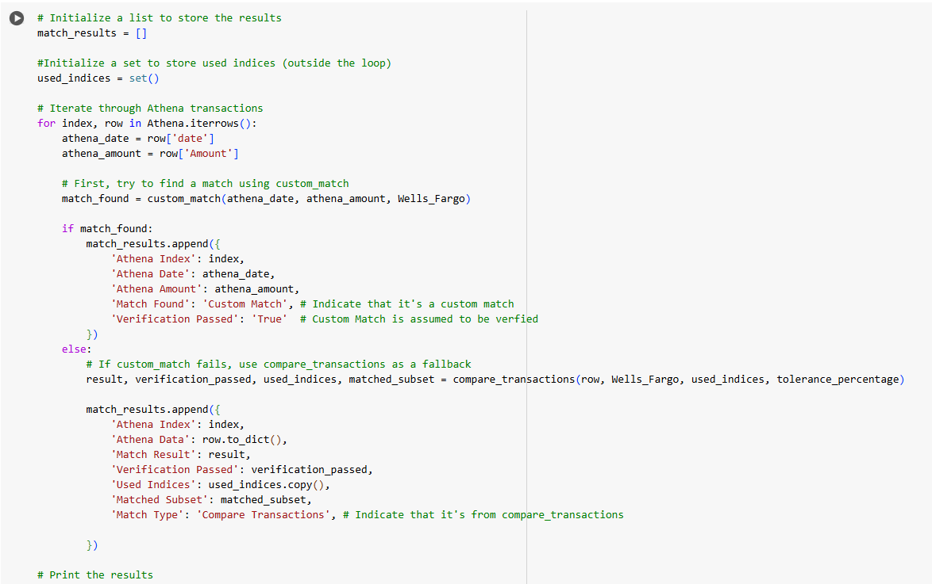
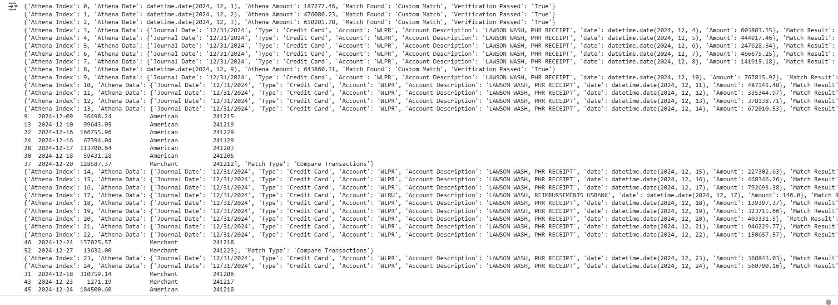
TWO STEP MATCHING STRATEGY
Iterate through each transaction to find a corresponding match
Returns: match_results list
Notes:
Overall Goal
The cell's primary objective is to iterate through each transaction in the Athena DataFrame and try to find a corresponding match in the Wells_Fargo DataFrame. It employs a two-step matching strategy:
custom_match: It first attempts to use a function called custom_match to find matches based on specific criteria (date, amount, keywords).
compare_transactions: If custom_match fails, it falls back to a more general function called compare_transactions which uses a more flexible algorithm.
The cell then stores the results of these matching attempts in a list called match_results, which will be used later for analysis and reporting.
In Summary
This cell is a core part of the transaction matching process. It systematically goes through each Athena transaction, tries to find a match in Wells_Fargo using two different strategies, and meticulously records the outcome of each attempt in the match_results list. This list then serves as a foundation for further analysis, reporting, and visualization.
Code Breakdown
Initialization
match_results = []: Creates an empty list called match_results. This list will store the outcome of the matching process for each Athena transaction. Each element in this list will be a dictionary containing information about the matching result.
used_indices = set(): Creates an empty set called used_indices. This set is crucial for keeping track of which Wells_Fargo transactions have already been used in a match. This prevents a single Wells_Fargo transaction from being matched to multiple Athena transactions.
Iterating Through Athena Transactions
for index, row in Athena.iterrows():: This loop iterates through each row in the Athena DataFrame.
index: The index (row number) of the current Athena transaction.
row: A pandas Series containing the data for the current Athena transaction.
Extracting Transaction Details
athena_date = row['date']: Extracts the date of the current Athena transaction.
athena_amount = row['Amount']: Extracts the amount of the current Athena transaction.
Attempting custom_match
match_found = custom_match(athena_date, athena_amount, Wells_Fargo): Calls the custom_match function to attempt to find a match in the Wells_Fargo data for the current Athena transaction. It takes the athena_date, athena_amount, and the entire Wells_Fargo DataFrame as input.
custom_match returns True if it finds a match based on its specific logic (looking for "Merchant" and "American" in descriptions within a date range), and False otherwise.
Handling custom_match Success
if match_found:: Checks if custom_match found a match.
The code then creates a dictionary to store the match information and appends this dictionary to the match_results list.
'Athena Index': index: Stores the index of the matched Athena transaction.
'Athena Date': athena_date: Stores the date of the Athena transaction.
'Athena Amount': athena_amount: Stores the amount of the Athena transaction.
'Match Found': 'Custom Match': Indicates that a match was found using the custom_match function.
'Verification Passed': 'True': Because custom_match has specific requirements, if it finds a match it is assumed to be correct.
Handling custom_match Failure
else:: This block executes if custom_match did not find a match.
result, verification_passed, used_indices, matched_subset = compare_transactions(row, Wells_Fargo, used_indices, tolerance_percentage): Calls the compare_transactions function as a fallback. This function attempts a more general match based on amount and date, considering the used_indices set and a tolerance percentage.
compare_transactions returns several values:
result: A string indicating the type of match outcome ('Match', 'No Match', etc.).
verification_passed: A boolean indicating if the match (if any) is considered verified.
used_indices: The updated set of used Wells_Fargo transaction indices.
matched_subset: If a match was found it returns a list that contains a dataframe of the matched rows.
The code creates a dictionary to store the match information and appends this dictionary to the match_results list.
'Athena Index': index: Stores the index of the Athena transaction.
'Athena Data': row.to_dict(): Stores the entire Athena transaction data as a dictionary.
'Match Result': result: Stores the matching result (e.g., 'Match', 'No Match').
'Verification Passed': verification_passed: Stores whether the match was verified.
'Used Indices': used_indices.copy(): Stores a copy of the used_indices set at this point in the process.
'Matched Subset': matched_subset: Stores the data frame of the rows that were matched.
'Match Type': 'Compare Transactions': Stores the fact that this match was found by the compare_transactions function.
Printing Results
for result in match_results:: Loops through the match_results list, which now contains all the matching outcomes.
print(result): Prints each dictionary in the match_results list. This gives a summary of the matching results for each Athena transaction.

Slide 7
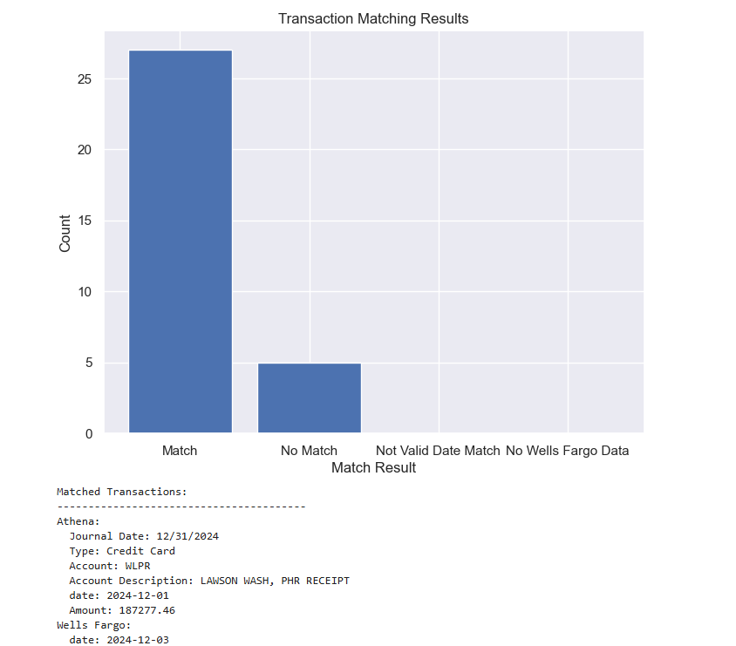
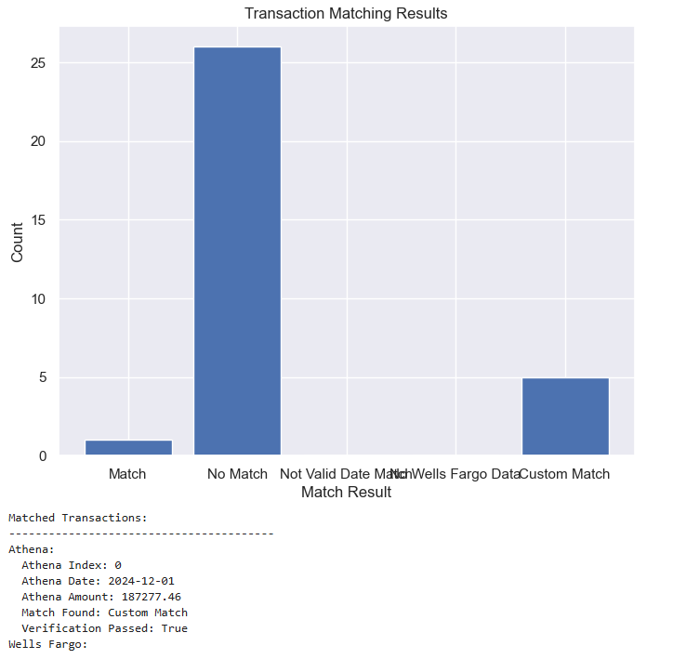
MATCHING TRANSACTION RESULTS
After numerous iterations
Notes:
The results shown in the image on the left are from the first attempts at matching. Although the results look positive, after further analysis the matching logic was not identifying matches appropriately or accurately. The image on the right, are the results after numerous iterative processes and various algorithms initiated to support identification of accurate financial transaction matching. As you can see there are two columns that indicate matches and another of no match. The separate matching columns are to identify which matching logic the match came from. As you also can clearly see, the ‘no match’ column is much greater. This is due to an issue with handling variances. Which I will explain shortly.
This code block efficiently:
Matches transactions: Iterates through Athena transactions and attempts to match them with Wells_Fargo transactions within a date range.
Manages indices: Prevents double-counting of Wells_Fargo transactions by keeping track of used indices.
Identifies unmatched data: Determines and reports which Wells_Fargo transactions remain unmatched after the matching process.
This code is designed to handle the complexities of comparing two datasets for matching purposes, ensuring that matches are made logically and that unmatched data is clearly identified.
Core Functionality
The code block has three main functionalities:
Matching Transactions: It iterates through the Athena transactions and attempts to find matching transactions in Wells_Fargo using the compare_transactions function.
Tracking Used Indices: It keeps track of which indices (rows) in Wells_Fargo have already been matched to an Athena transaction. This prevents double-counting or using the same Wells_Fargo transaction for multiple matches.
Identifying Unmatched Transactions: After attempting to match all Athena transactions, it identifies any Wells_Fargo transactions that were never used in a match.
Code Breakdown
1. Initialization
used_indices = set(): This initializes an empty set called used_indices. This set will store the indices of Wells_Fargo transactions that have been used in a match. Sets are used because they efficiently store unique elements.
results = []: This initializes an empty list called results. This list will store the results of the matching process for each Athena transaction. Each element in the list will be a dictionary with information about the match attempt.
tolerance_percentage = 0.05: This sets the tolerance percentage for matching to 5%. This is a parameter used by the compare_transactions function.
all_wells_fargo_indices = set(Wells_Fargo.index): Creates a set of all indices in the Wells Fargo dataframe. This set will be used to determine which indices are not matched to a value in the Athena dataframe.
2. Looping Through Athena Transactions (with Date Range)
for athena_date in Athena['date'].unique():: This loop iterates through each unique date found in the Athena DataFrame's 'date' column. This allows the matching to be done on a per-day basis (or within a certain date range).
date_range_start = athena_date - timedelta(days=7): Calculates a start date for a 7-day date range before the athena_date.
date_range_end = athena_date + timedelta(days=7): Calculates an end date for a 7-day date range after the athena_date.
athena_subset = Athena[(Athena['date'] >= date_range_start) & (Athena['date'] <= date_range_end)]: Filters the Athena DataFrame to include only transactions within the calculated date range.
wells_fargo_subset = Wells_Fargo[(Wells_Fargo['date'] >= date_range_start) & (Wells_Fargo['date'] <= date_range_end)]: Filters the Wells_Fargo DataFrame to include only transactions within the same date range.
for index, row in athena_subset.iterrows():: This loop iterates through each row (transaction) in the athena_subset DataFrame.
result, verification_passed, used_indices, matched_subset = compare_transactions(row, wells_fargo_subset, used_indices, tolerance_percentage): Calls the compare_transactions function to attempt to find a match for the current Athena transaction within the wells_fargo_subset.
row: The current Athena transaction (as a pandas Series).
wells_fargo_subset: The Wells_Fargo transactions within the date range.
used_indices: The set of Wells_Fargo indices that have already been used.
tolerance_percentage: The tolerance allowed for matching amounts.
results.append({...}): Stores the result of the match in the results list.
'Athena Index': index: Stores the index of the athena row.
'Athena Data': row.to_dict(): Stores the row as a dictionary.
'Match Result': result: Stores the result of the match.
'Used Indices': used_indices.copy(): Stores a copy of the used indices set.
'Matched Subset': matched_subset: Stores the dataframe of the rows matched.
3. Updating all_wells_fargo_indices
if result == 'Match' and matched_subset is not None:: Checks if a match was found and if a subset of rows was returned.
all_wells_fargo_indices.difference_update(matched_subset[0].index): If a match was found, this line updates the all_wells_fargo_indices set.
matched_subset[0].index: Gets the index from the dataframe of the rows that were matched.
all_wells_fargo_indices.difference_update(): removes the index of the matched rows from the all_wells_fargo_indices set.
4. Reporting Unmatched Transactions*
unmatched_wells_fargo = Wells_Fargo[Wells_Fargo.index.isin(all_wells_fargo_indices)]: After the matching process is complete, this line filters the Wells_Fargo DataFrame to include only the transactions whose indices are still present in the all_wells_fargo_indices set (meaning they were never matched).
print("Unmatched Wells Fargo Transactions:"): Prints a header for the unmatched transactions.
print(unmatched_wells_fargo): Prints the Wells_Fargo transactions that were not matched to any Athena transaction.
In Summary
This code block efficiently:
Matches transactions: Iterates through Athena transactions and attempts to match them with Wells_Fargo transactions within a date range.
Manages indices: Prevents double-counting of Wells_Fargo transactions by keeping track of used indices.
Identifies unmatched data: Determines and reports which Wells_Fargo transactions remain unmatched after the matching process.
This code is designed to handle the complexities of comparing two datasets for matching purposes, ensuring that matches are made logically and that unmatched data is clearly identified.

Slide 8
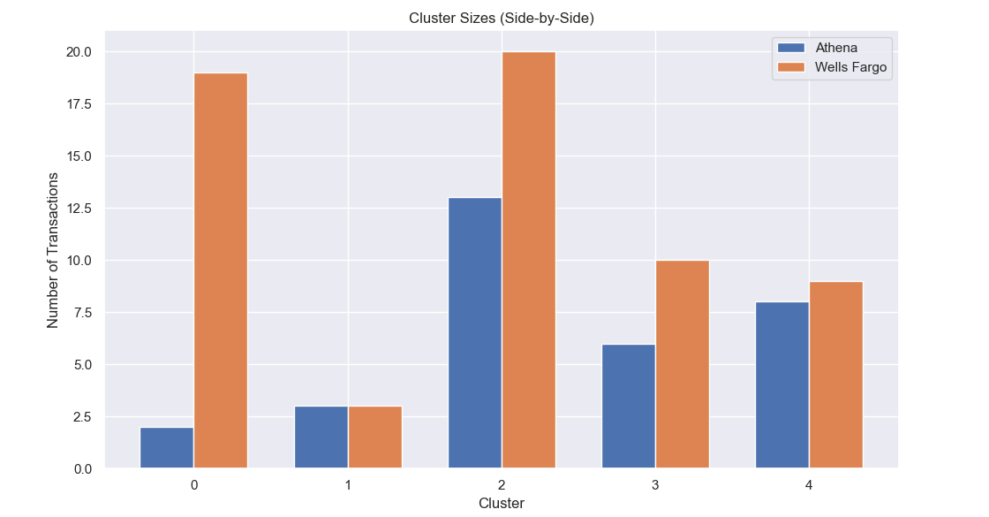
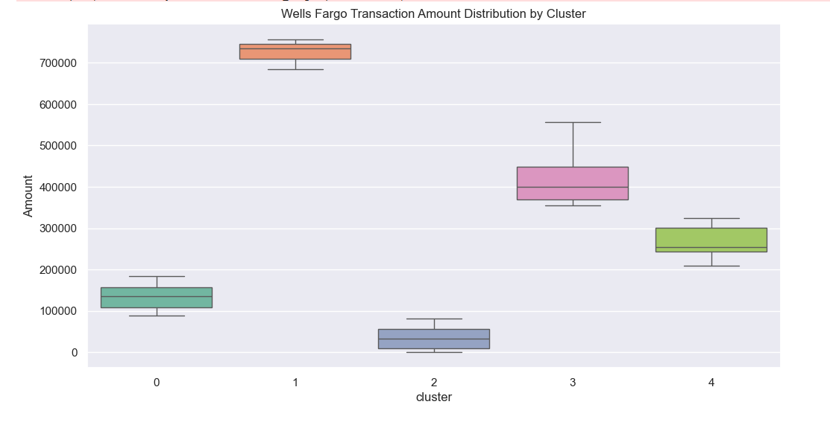
FURTHER ANALYSIS
Notes:
K-means Clustering
Data Preparation:
Focused on the Amount and date columns from both the Athena and Wells Fargo datasets.
Applied TF-IDF vectorization to the Type column in Athena and Transaction detail in Wells Fargo to capture textual information.
The Amount column was standardized using StandardScaler to ensure both features contribute equally to distance calculations.
Clustering:
K-means clustering with k = 5 (5 clusters) on the combined features.
The algorithm assigned each transaction in both datasets to one of the 5 clusters based on feature similarity.
Visualization:
(In the full notebook) Created a scatter plots to visualize the cluster distribution, with scaled Amount on the x-axis and dataset source (Athena or Wells Fargo) on the y-axis.
Bar charts were used to compare the number of transactions in each cluster for both datasets.
Analysis:
Cluster Statistics: I calculated statistics (mean, standard deviation, min, max, count) for the Amount within each cluster for both datasets. This helps understand the characteristics of transactions in each cluster. However, I found not useful for this project or for what Im trying to achieve.
Cluster Comparison: compared cluster statistics between Athena and Wells Fargo to identify similarities or differences in transaction patterns across clusters.
Transaction Distribution: I examined the distribution of transactions within clusters to see if there are any dominant transaction types or patterns associated with specific clusters.
Outlier Detection: You used z-scores to identify outliers within each cluster, which could indicate unusual or potentially fraudulent transactions.
Overall Observations:
The K-means clustering analysis helps understand the different transaction patterns and segments within the data.
The random forest model provides a way to automate the matching process and predict matches between transactions from the two datasets.
The visualizations and analysis techniques used help gain insights into the data and the performance of the clustering and classification models.
Analysis:
Model Performance: I evaluated the model's performance using metrics like accuracy and classification report (precision, recall, F1-score) on the validation set.
Prediction Results: I used the trained model to predict matches on new, unseen transactions and analyzed the results.
Random Forest
Data Preparation:
I used the match_results from the previous matching process to create a labeled dataset for training the model.
The Athena Amount and Description columns were extracted from the match_results.
TF-IDF vectorization was applied to the Description column to capture textual information.
The Athena Amount was standardized using StandardScaler.
Model Training:
Trained a random forest classifier with random_state = 42 for reproducibility.
Used GridSearchCV to tune the n_estimators hyperparameter (number of trees) with values [100, 200, 300].
The model was evaluated on a validation set, and the best-performing model based on validation accuracy was selected.
Prediction:
I created a predict_match function to predict whether two transactions are a match based on the trained model.
The function takes two transactions (one from Athena and one from Wells Fargo) as input, extracts and preprocesses the relevant features, and uses the trained model to make a prediction.

Slide 9
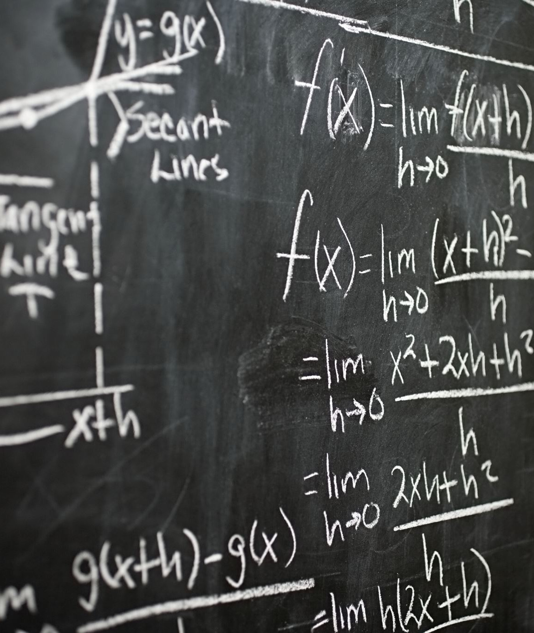
LESSONS LEARNED
Observations:
Time Processing
Different tolerance levels
Date fluctuations
Matching occurs mainly on days with zero variance, cannot seem to get an accurate variance threshold to mitigate the logic from skipping as a match
Notes:
Time Processing Variations:
I observed that the time required to process and match transactions varied significantly depending on factors like the number of transactions and tolerance levels and the complexity of the matching logic or algorithms used.
For example, Matching transactions from Wells Fargo database that had one Merchant Card and one American Express transaction on a single day that matched to Athena database it didn’t take long to match. But if there were any variations in dates or many to one matches, then it took several minutes and most commonly was deemed “Un-Matched”
Limitations with Date Variances:
The analysis revealed limitations in accurately matching transactions when there were discrepancies in the recorded dates between the two datasets. This highlights the importance of consistent date recording practices
For instance, I found that transactions with date differences of more than 5 days were often difficult to match reliably.
False Positives and Inaccurate Matches:
Initially, the algorithm produced a high number of matches, but further investigation revealed that many of these were false positives or had inaccurate amounts. This emphasized the need for refining the matching criteria and incorporating stricter validation checks.
In the initial run, approximately 90% of the matches were either false positives or had significant discrepancies in amounts.
Iterative Refinement:
The process required iterative refinement of the algorithms and parameters to improve accuracy and reduce errors. This highlights the importance of continuous evaluation and adjustment in data science projects.
Briefly mention specific refinements made, such as adjusting tolerance levels, adding new rules, different algorithms

Slide 10

THE JOURNEY CONTINUES: NEXT STEPS
Continue Refinement
Complete remaining sections
If/when Successful implement
Q&A

